Slide 1


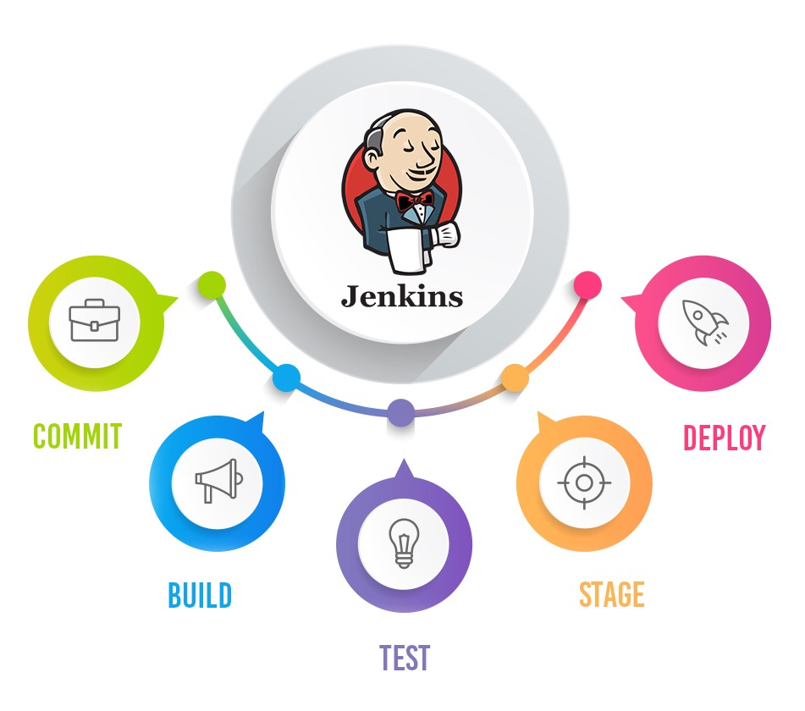
Jenkins Mastery for Software Tester
Pramod Dutta
Email Notification of Build in Jenkins

Slide 2

What we need to Email?
You can send the email report based on failure or pass to Stakeholders
You can customize the reports.
You can attach log and HTML results

Slide 3
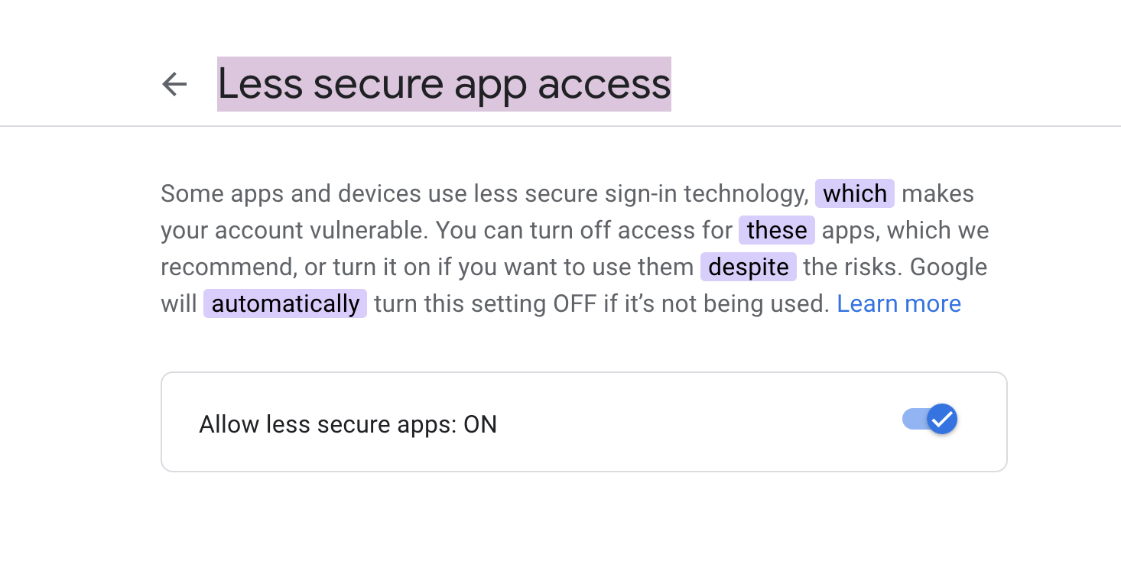
How to configure the gmail to Jenkins
https://myaccount.google.com/u/2/lesssecureapps

Slide 4
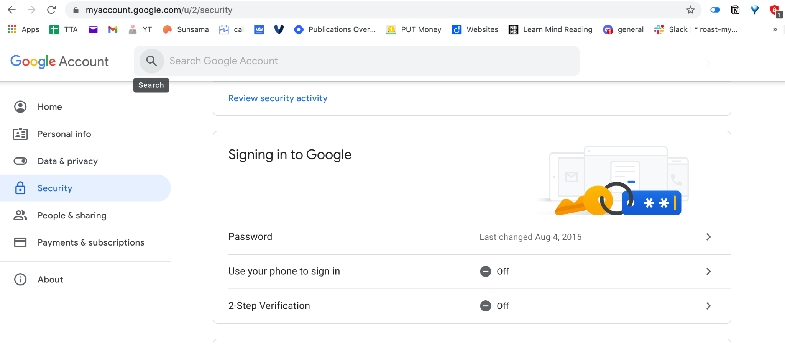
How to configure the gmail to Jenkins
Switch off the TFA and switch off the security

Slide 5
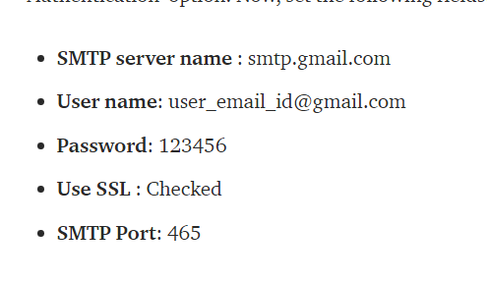
What we need to Do?
Email Our report to Recipients
Email-ext plugin
http://localhost:8080/configure
Skip+Certificate+Check+plugin

Slide 6
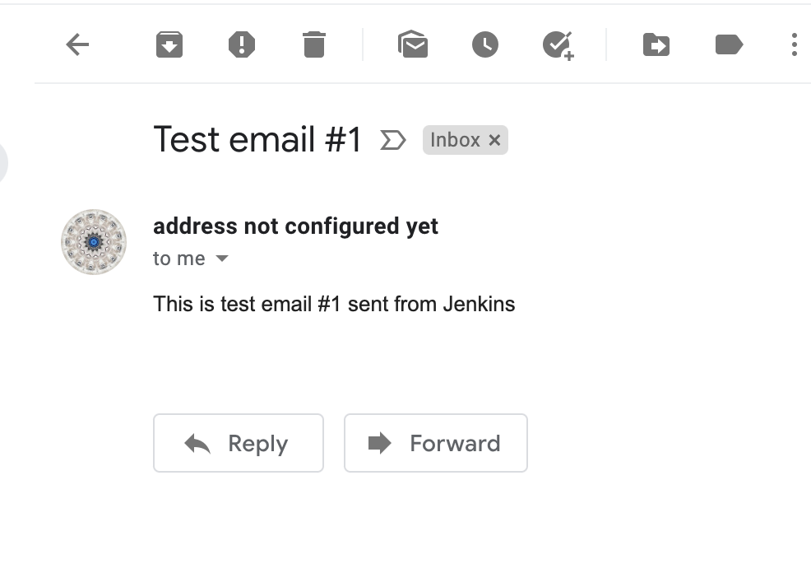
Test Configuration
Navigate to http://localhost:8080/configure
Enter details and check

Slide 7
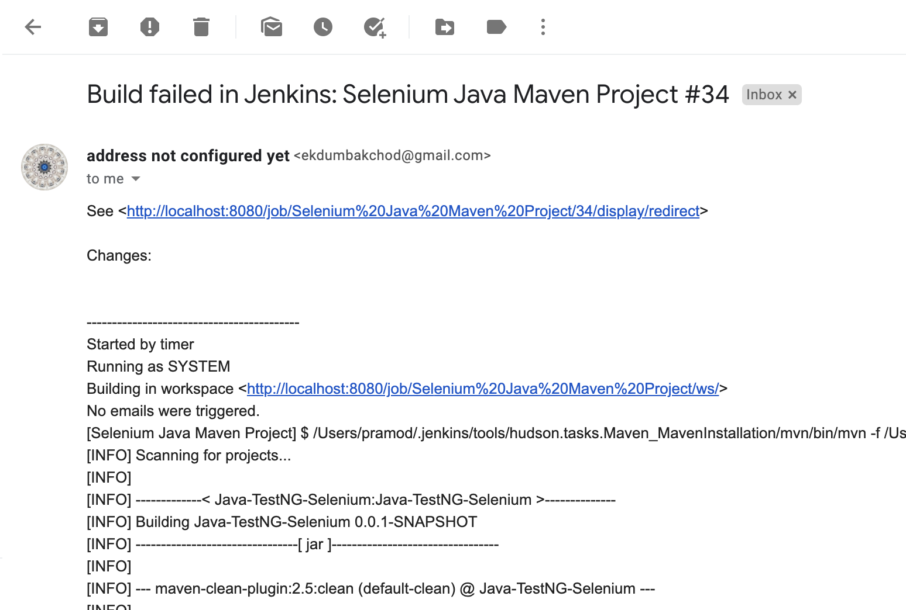
Email with Logs on Failure.

